Slide 1


Asia Pacific College
Disaster Response
Bueno | Belchez | Malapo | Mortera
Software Development | Quality Project - 2016 - 2017

Slide 2
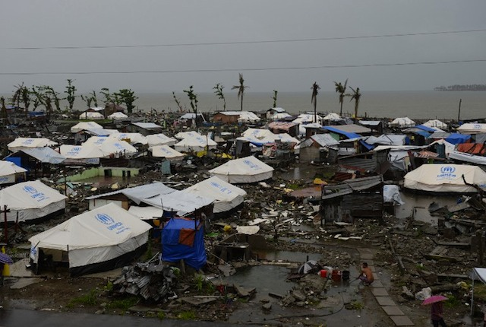
Main Client(s):

Slide 3
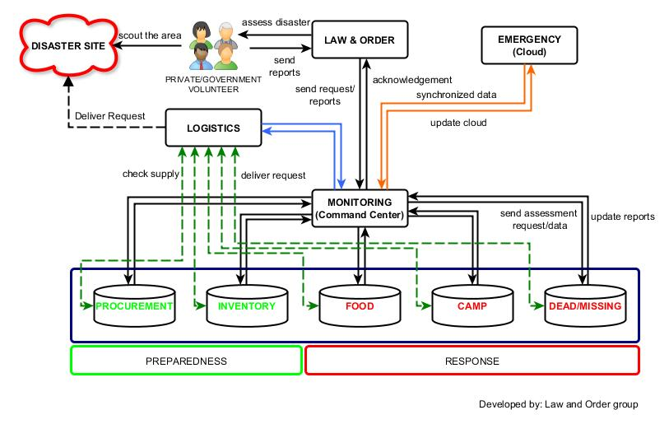
OVER-ALL System architecture

Slide 4
Law and Order
Bueno | Belchez | Malapo | Mortera

Slide 5
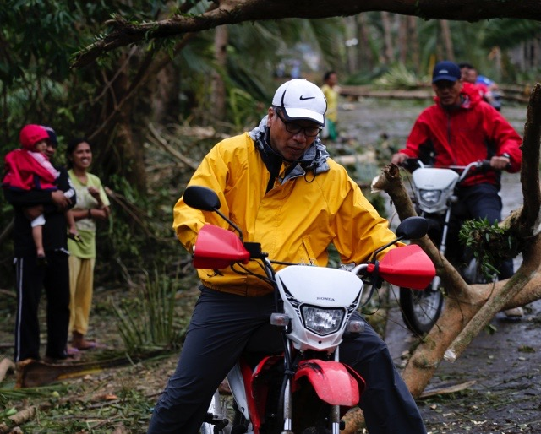

Law and Order
MISSION: To ensure that peace and order will be upheld during disaster
LEAD AGENCY: Philippine National Police

Slide 6





MEMBER AGENCIES:
AFP,DFA, OCD, DILG, DOH, MMDA, REACT, NBI, PRC, PNP, BFP, DPWH, PCG, IFRC, ICRC, UNDAC and Private / Volunteer Groups

Slide 7
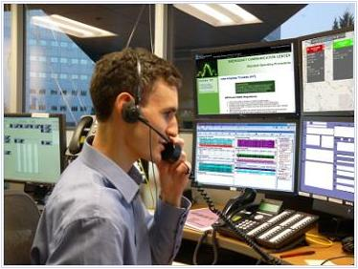
Scope and Objectives:
Identify the disaster and area affected
Identify the hazard category and governance level
Assess the rate of damage and the victims
Deploy response and support functions
Communication between the respondents
Maintain PEACE and ORDER.

Slide 8
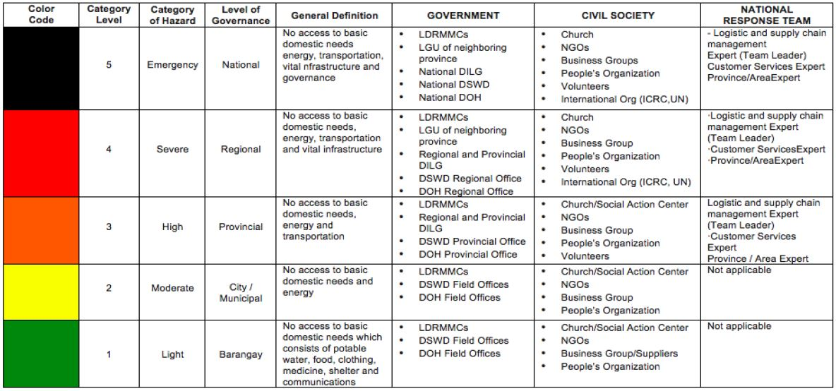
Level of Disaster

Slide 9
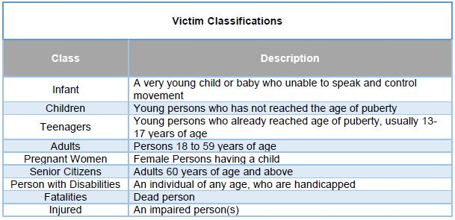
Identify Victims

Slide 10
Response and Support Functions
Food and Non-Food Supplies
Transportation Vehicle (Land/Air/Water)
Medical and Health Supplies and Support
Search and Rescue Operation
Retrieval of Tools and Supplies
Deployment of Camp and Shelter

Slide 11
Technical Requirement(s)
Communication Device(s)
Handheld/Mobile Device(s)
System (Server)
Telecommunication Network (Internet)

Slide 12
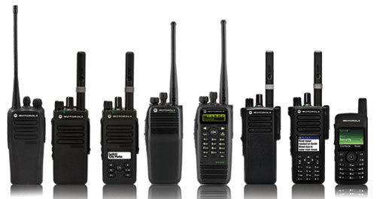
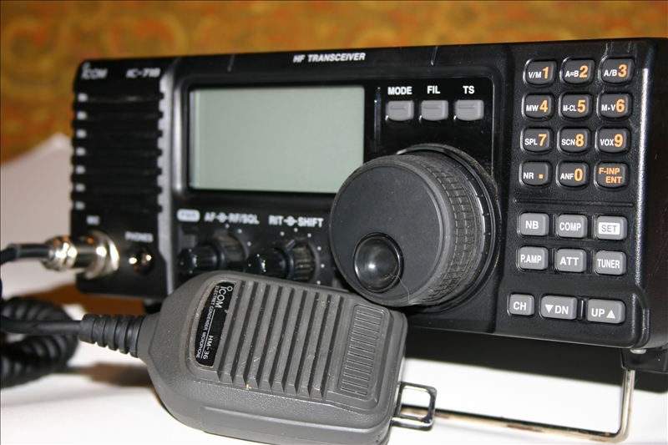
Communication Devices

Slide 13
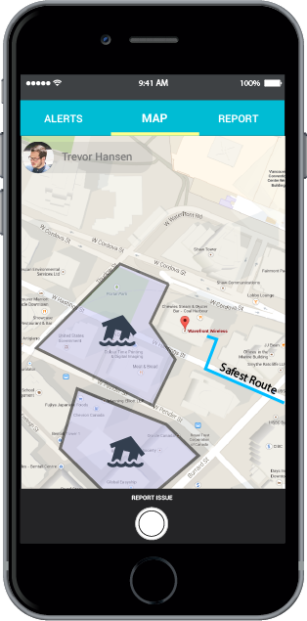
Command and Response APP
A proprietary mobile app which uses wireless mesh networking (Bluetooth or Wi-Fi) to enable smartphones communicate even without network or Internet connection.

Slide 14
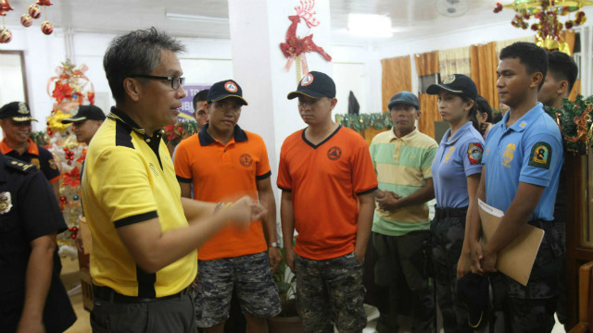
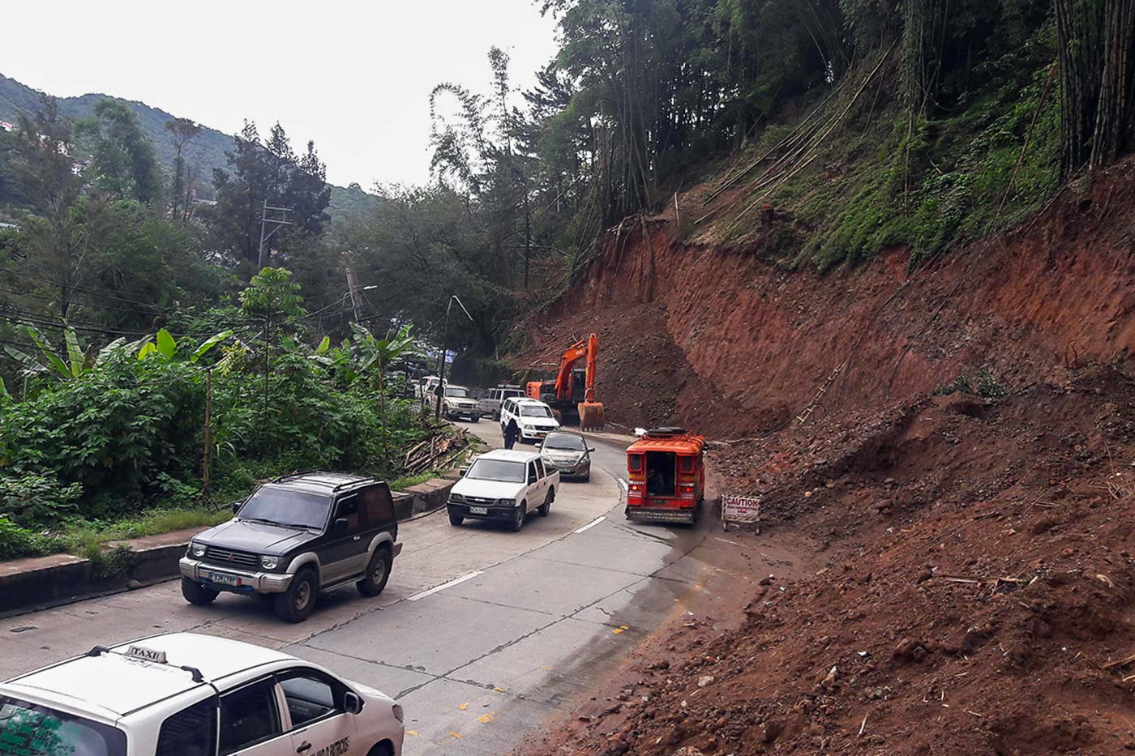
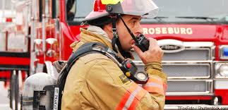

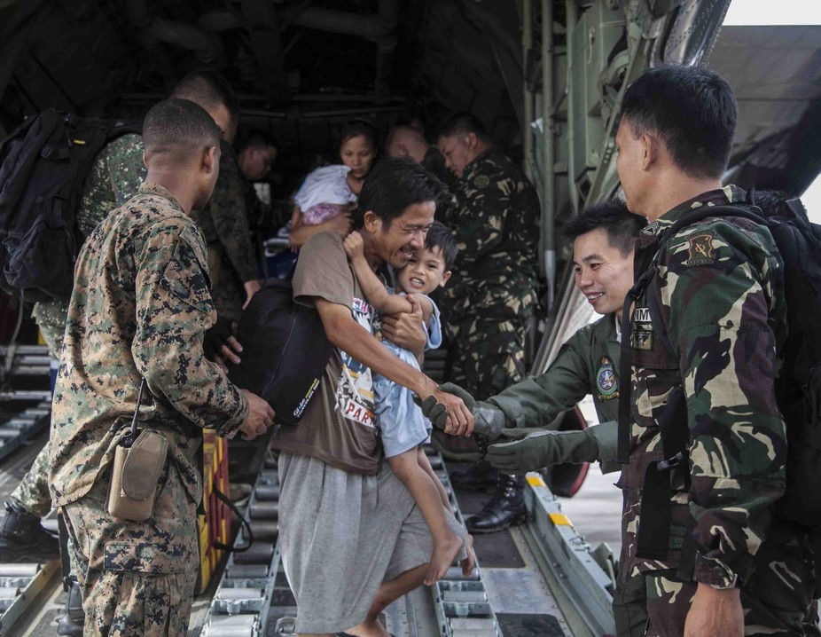
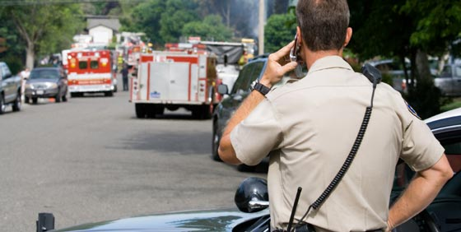
TRANSMIT REPORTS / COMMANDS

Slide 15

Requirements & Specifications
Mobile Device (API 16 up to latest)
Bluetooth or Wi-Fi Connectivity

Slide 16
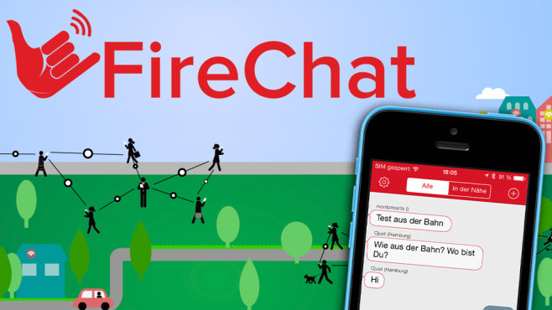
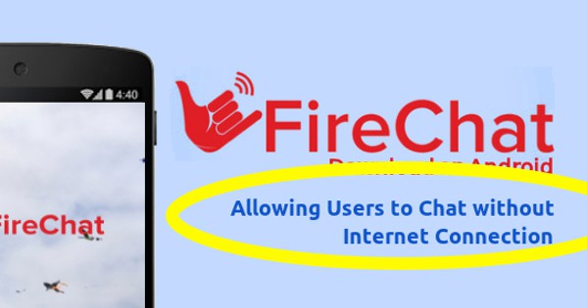
Similar APP

Slide 17
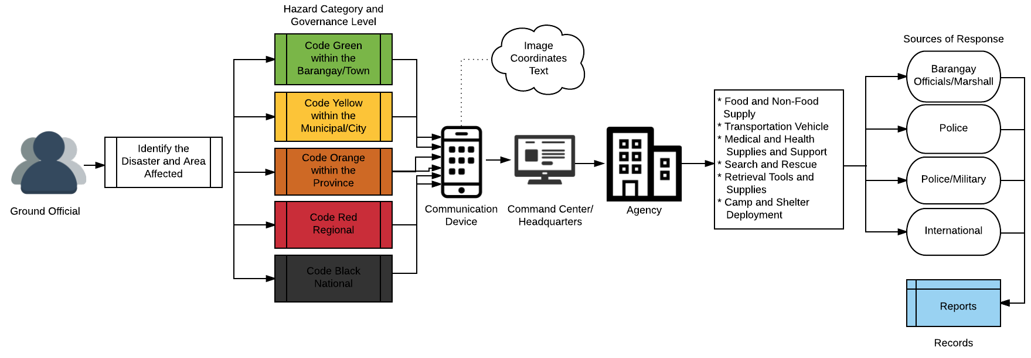
Conceptual Framework Diagram

Slide 18
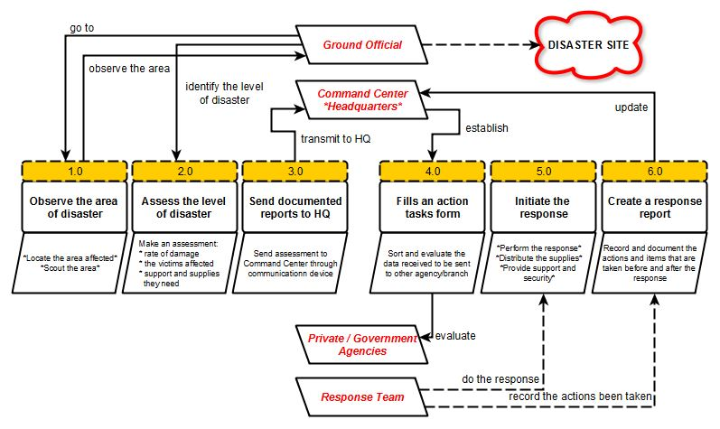
data-flow diagram

Slide 19
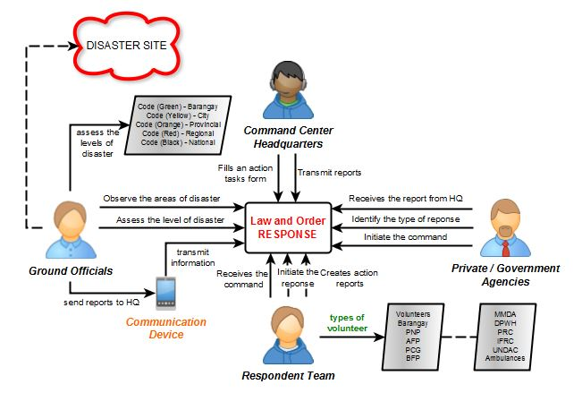
Context-flow diagram

Slide 20
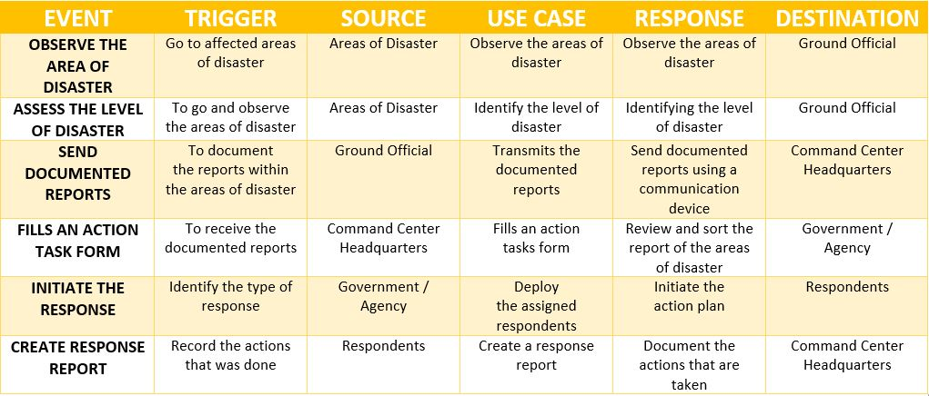
Event Table

Slide 21
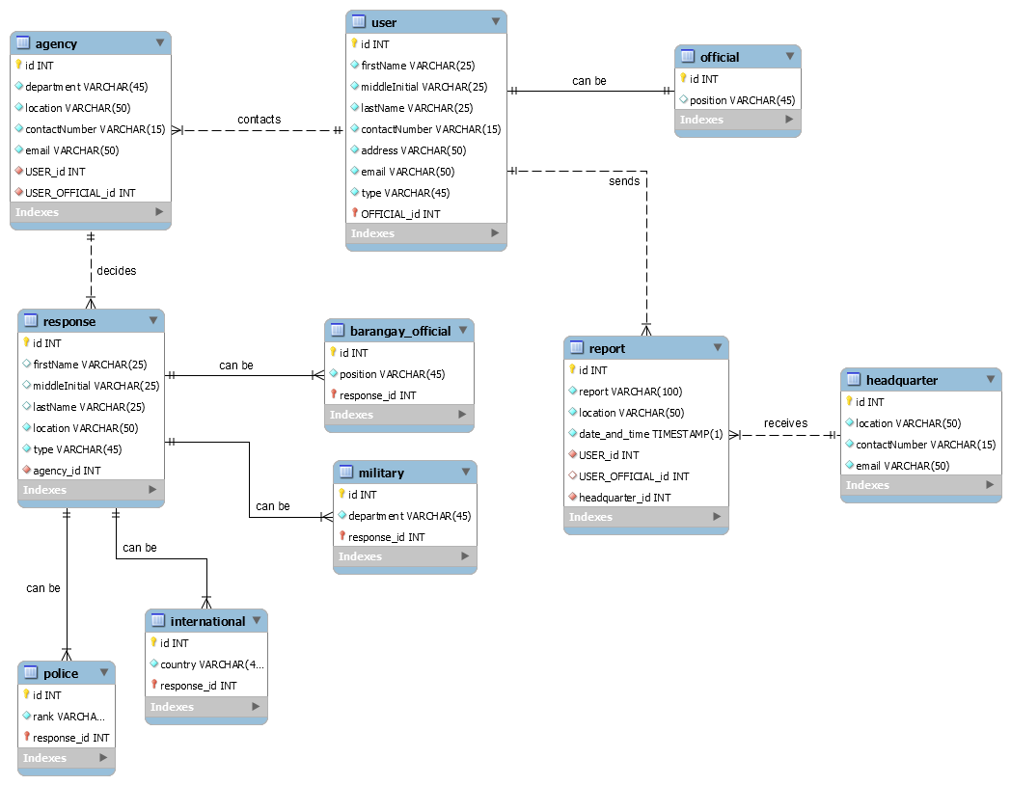
Entity-relationship diagram

Slide 22


- System demo -
Prototype

Slide 23
Quality assurance checklist

Slide 24
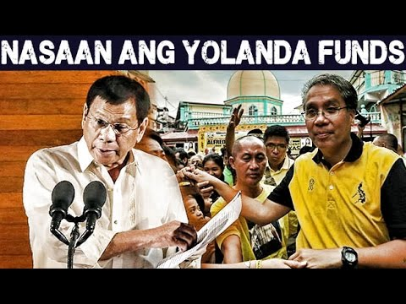
God bless us all!

